Slide 1
Mobile Application Development
Recap

Slide 2





What you will learn in this course
Ionic Framework
Angular
Git / Command Line
TypeScript / ES6
Basic Understanding of Node.js

Slide 3
Grading and Evaluation
Module | Weightage
Quiz and Assignments | 10%
Project | 20%
Midterm | 20%
Final | 50%

Slide 4
Different ways to Build Mobile Apps
Using Native SDKs
Android – Java / Kotlin
iOS – Swift, Objective C.
Hybrid App Development Ionic Framework, React Native, Flutter.

Slide 5



Ionic vs React Native vs Flutter
 | Ionic | React Native | Flutter
Language | HTML / CSS /JavaScript | HTML / CSS /JavaScript | Dart
UI Framework | Angular / React / Vuejs / Vanilla JS | React JS | -
Uses WebView | Yes | No | No
Founded | 2013 | 2015 | 2017
Ideal for intense graphic apps? | No | Moderately | Yes

Slide 6
Introduction to Ionic
Ionic Framework is the free, open source mobile UI toolkit for developing high-quality cross-platform apps for native iOS, Android, and the web—all from a single codebase.
Ionic can be used with any JS Framework. Angular / React / Vuejs / or even Vanilla JS.
Very fast development speed. Incredibly fast to prototype and build native looking apps.
Ionic uses WebView. Which means an Ionic app runs inside a hidden browser (headless browser). This is its major difference with React Native and Flutter.

Slide 7
Why Angular
Angular is an all-in-one solution (Routing/HTTP/Forms/Services/RxJS). Angular really provides so much out of the box (Directives, Pipes etc)
React.js is just a library. In order to to build complete front-end applications, you need to use react-router (router), formik (forms), redux/mobx (state management).
Vue.js would also require vue-router and vuex.
Provides modular concept which helps for code reuse and easier scaling of architecture.

Slide 8
Frontend and Backend options
Frontend Frameworks / Libraries
jQuery, AngularJS, Angular, React.js, Vuejs, Aurelia, Ember, Knockout, Svelte etc
Backend Options / Frameworks
Nodejs, C#, Python, Java, Go, Rust, Elixir, PHP etc
Nodejs Frameworks ( Express.js, Nest.js, Loopback.js, Koa, Sails, Socket.IO, Hapi.js etc )

Slide 9

Introduction to TypeScript
TypeScript is an open-sourced programming language developed and maintained by Microsoft.
Typescript is a super-set of JavaScript to compiles to plain JavaScript. Superset (anything u can do in JS, u can also do in typescript) and adds some extra features.
TypeScript is modern JavaScript (ES6,ES7+) + types. It's about catching bugs early and making you a more efficient developer.

Slide 10
Angular Modules
Modules is a mechanism to group components, directives, pipes and services that are related, in such a way that can be combined.
A Module is a collection of different components (usually with a similar functionality)
By Default, we have 1 App module. We can create modules ourselves depending on our needs.

Slide 11
Type of Directives
There are three main types of directives in Angular:
Component - directive with a template. (yes components are a directive)
Attribute directives - directives that change the behavior of a component or element but don't affect the template. E.g ngClass, ngStyle
Structural directives - directives that change the behavior of a component or element by affecting how the template is rendered . E.g *ngIf, *ngFor

Slide 12
Template Syntax in Angular
A template helps us to render HTML with some dynamic parts depending on our data.
{{ }} for interpolation.
[] for property binding.
() for event binding.
# for variable declaration.
* for structural directives.
Interpolation allows you to incorporate calculated strings into the text between HTML element tags and within attribute assignments. E.g {{ amount }} or {{ 2+4 }}. It can also include a JS expression
Notes:
Dont worry about memorizing these. You’ll understand them better once we use them later on.

Slide 13
Angular and Ionic Folder Structure
Package.json
If you see a package.json file, there’s few important properties which you need to know.
Scripts, dependencies and devDependencies.
Scripts include command line scripts which can be run to do various tasks. Scripts are basically shortcuts to common tasks e.g running a app, testing an app, deploying an app.

Slide 14
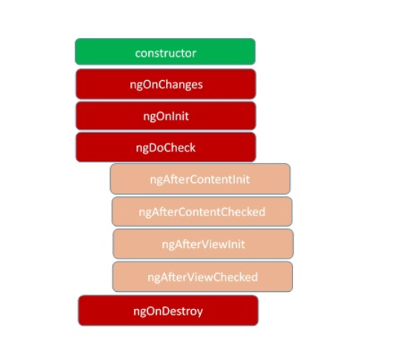
Lifecycle Methods in Angular
Since a component is a TypeScript class, every component must have a constructor method. The constructor of the component class executes, first, before the execution of any other lifecycle hook events.
After executing the constructor, Angular executes its lifecycle hook methods in a specific order.

Slide 15
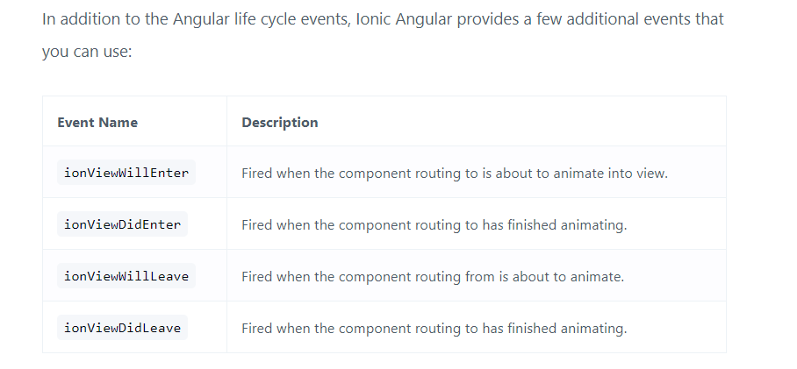
Ionic Page lifecycle
https://ionicframework.com/docs/angular/lifecycle

Slide 16
Template Driven vs Reactive Forms
In a template-driven approach, most of the logic is driven from the template, whereas in reactive-driven approach, the logic resides mainly in the component or typescript code.
Template Driven forms involve writing less code however it can get complicated very quickly.
Template Driven forms get complicated very quickly and are very difficult to handle when the forms get large.
Reactive forms or Model-driven forms are more robust, scalable, reusable, and testable.

Slide 17
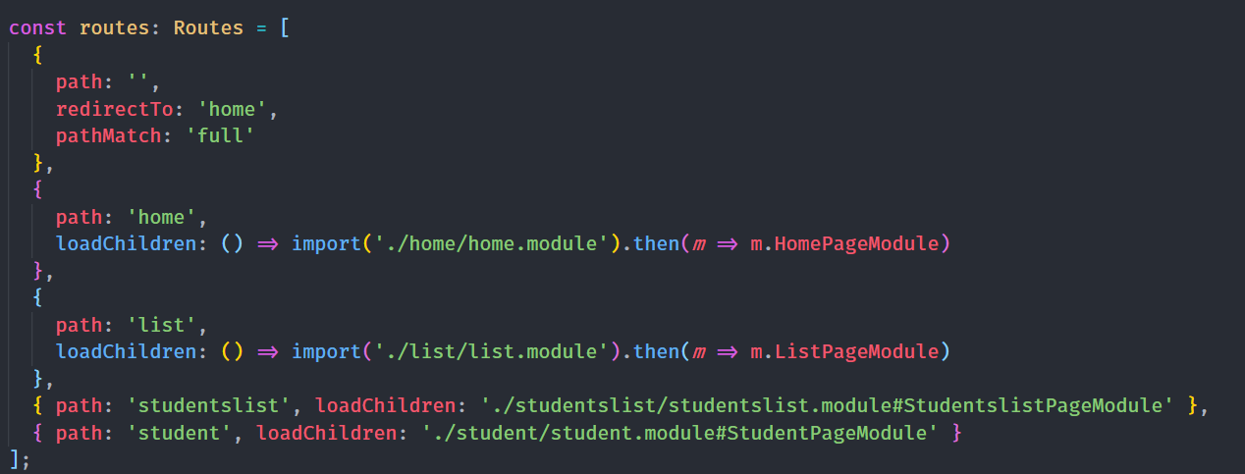
Ionic Routing and Navigation

Slide 18
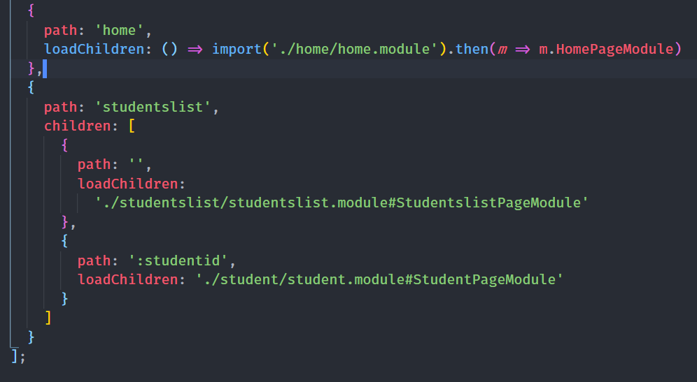
Ionic Routing and Navigation
Lets change the routing according to our requirements.
this will help us use urls like
http://localhost:8100/studentslist/3198
http://localhost:8100/studentslist/31989

Slide 19
State Management and Services in Angular
What is State? State is basically your data in the application.
Data that comes from the server, UI state like toggles (on / off), alerts and errors messages, User input, such as form submissions.
Managing state is hard when your application becomes complex. You need same data in multiple components. Now how are you going to make sure that its the same data?

Slide 20
Services
Angular provides Services by default which help us with state management across our application.
Angular services are singleton objects which get instantiated only once during the lifetime of an application.
They contain methods that maintain data throughout the life of an application, i.e. data does not get refreshed and is available all the time.

Slide 21
Services
The main objective of a service is to organize and share business logic, models, or data and functions with different components of an Angular application.
We might come across a situation where we need some code to be used everywhere on the page. Services help us achieve that. With services, we can access methods and properties across other components in the entire project.

Slide 22
Passing Data Between Components
Using Input(), Output() event emitters
This is ideal for parent, child components. However, once the number of components increase, this becomes hard.
Using a parents shared state
We declare the variable in the parent component and keep passing it down via Input. Can get complicated very quickly.

Slide 23
Passing Data Between Components
Using Services
This is mostly the desired approach when using Input(), Output() becomes complicated.
Using Store/NgRx
This is an option for large applications. Basically all the state is stored in one global store. We will not cover this in this course.

Slide 24
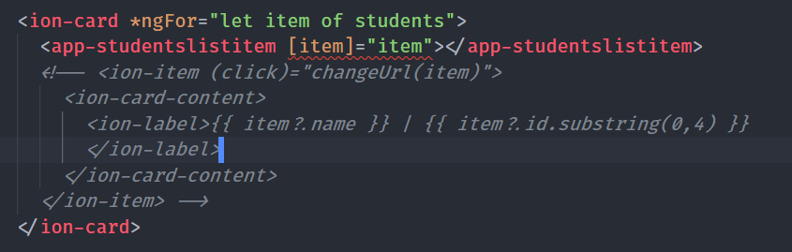
Passing Data Between Components
Now we pass via Input item variable to the component. But the linter is telling us that the component doesnot know what item is.

